Slide 1
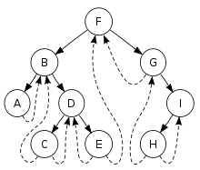
Threaded Binary Tree

Slide 2
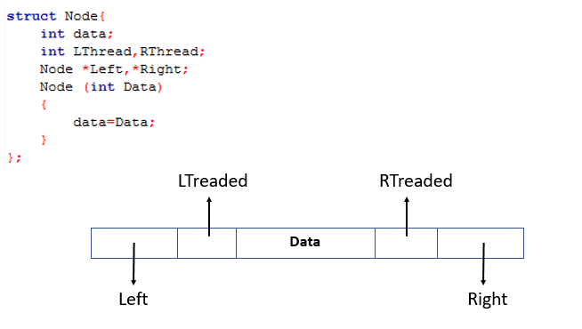
Threaded Binary Tree
Data structure

Slide 3
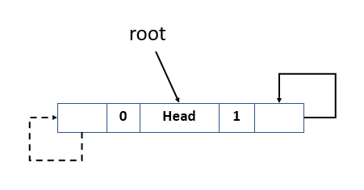
Threaded Binary Tree
Insertion

Slide 4
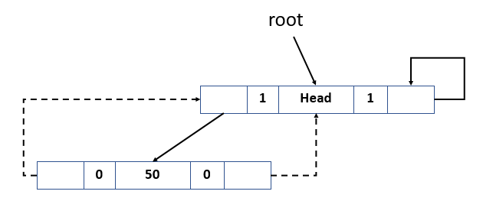
Threaded Binary Tree
Insertion 50

Slide 5
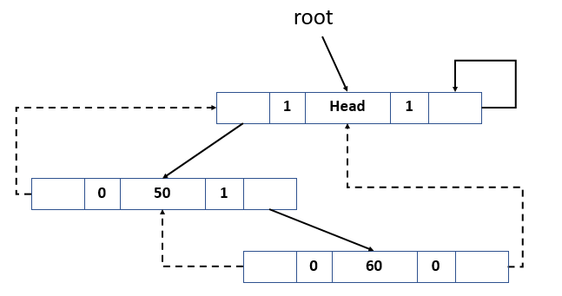
Threaded Binary Tree
Insertion 50 60

Slide 6
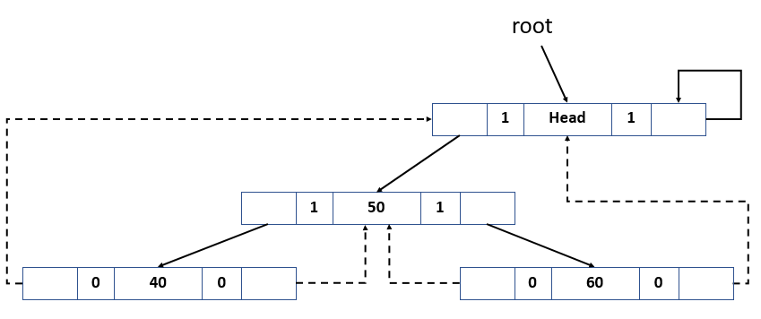
Threaded Binary Tree
Insertion 50 60 40

Slide 7
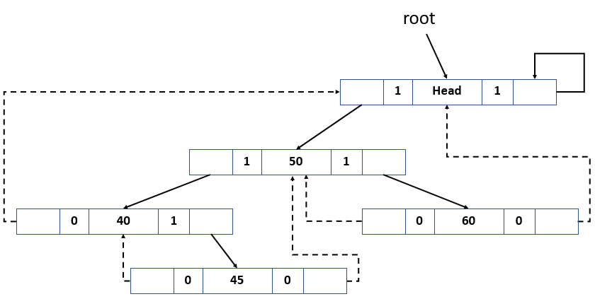
Threaded Binary Tree
Insertion 50 60 40 45

Slide 8
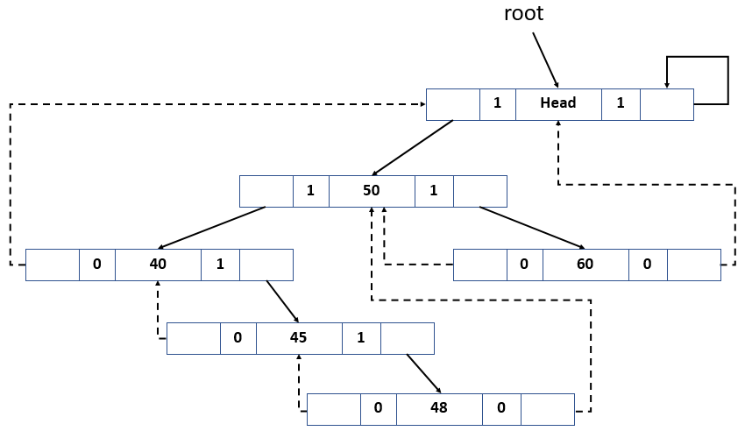
Threaded Binary Tree
Insertion 50 60 40 45 48

Slide 9
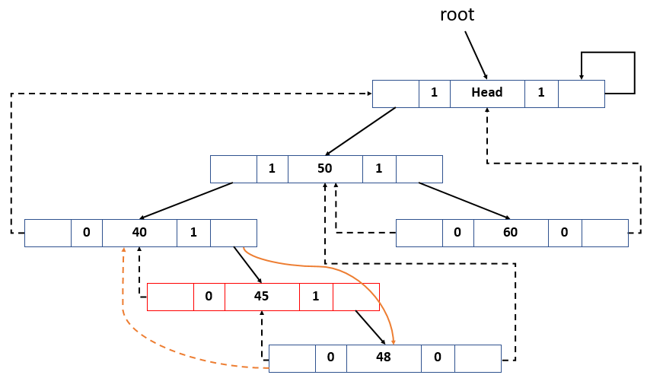
Threaded Binary Tree
Delete 45

Slide 10
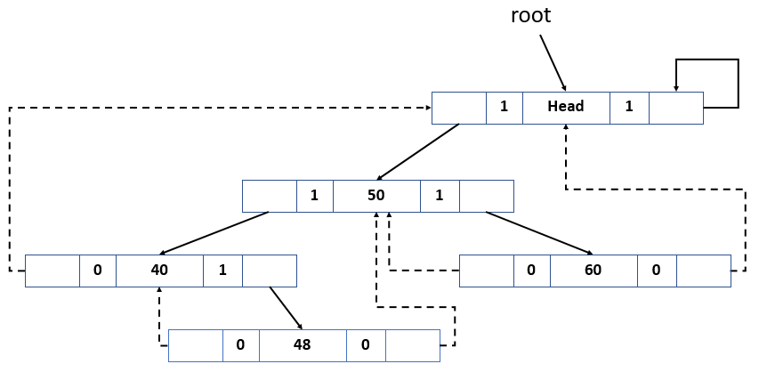
Threaded Binary Tree
Delete 45

Slide 11
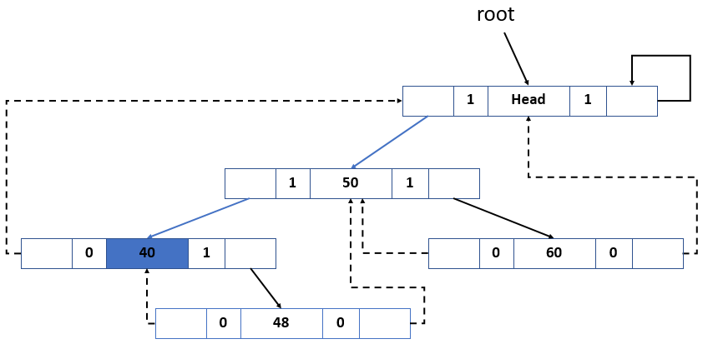
Threaded Binary Tree
Traversal Output 40

Slide 12
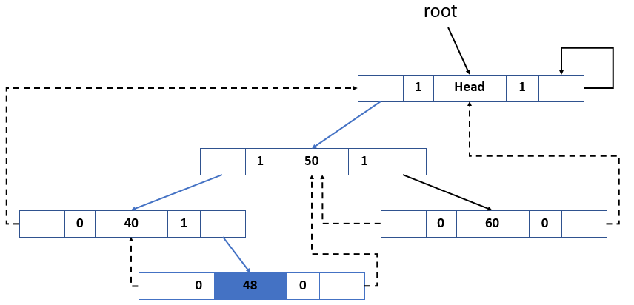
Threaded Binary Tree
Traversal Output 40 48

Slide 13
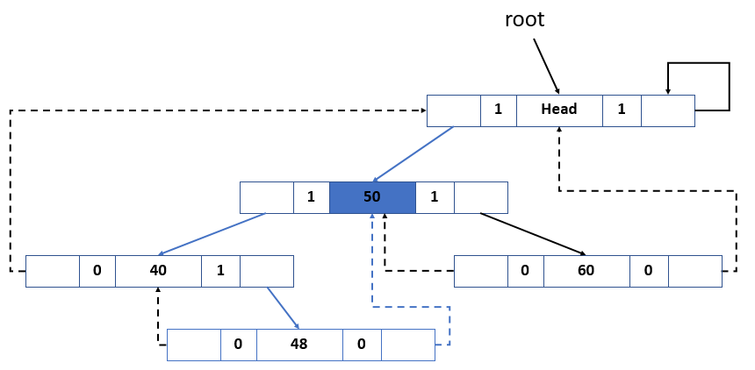
Threaded Binary Tree
Traversal Output 40 48 50

Slide 14
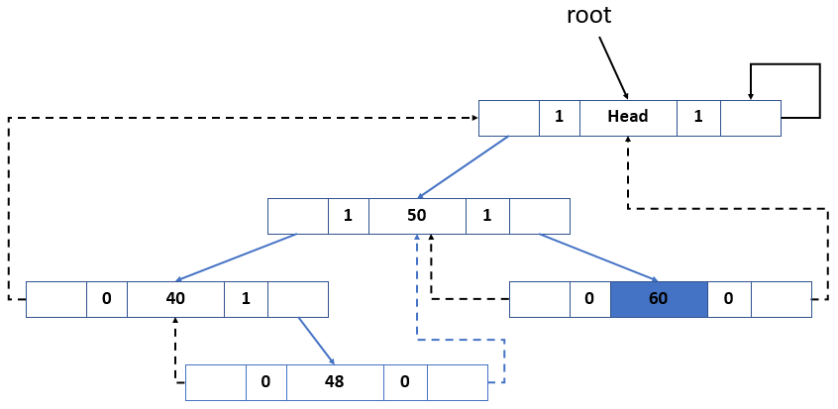
Threaded Binary Tree
Traversal Output 40 48 50 60

